Slide 1

Chapter 5 Concurrency: Mutual Exclusion and Synchronization

Slide 2
CS 345
Stalling’s Chapter | # | Project
1: Computer System Overview 2: Operating System Overview | 4 | P1: Shell
3: Process Description and Control 4: Threads | 4 | P2: Tasking
5: Concurrency: ME and Synchronization 6: Concurrency: Deadlock and Starvation | 6 | P3: Jurassic Park
7: Memory Management 8: Virtual memory | 6 | P4: Virtual Memory
9: Uniprocessor Scheduling 10: Multiprocessor and Real-Time Scheduling | 6 | P5: Scheduling
11: I/O Management and Disk Scheduling 12: File Management | 8 | P6: FAT
Student Presentations | 6

Slide 3
Step 1: Priority Queue
Project 2 Assignment
•••
Priority/TID
Priority/TID
Priority/TID
Priority/TID
# of entries
Create a priority queue
typedef int TID; // task ID
typedel int Priority; // task priority
typedef int* PQueue; // priority queue
PQueue rq; // ready queue
rq = (int*)malloc(MAX_TASKS * sizeof(int));
rq[0] = 0; // init ready queue
Queue functions
int enQ(PQueue q, TID tid, Priority p);
int deQ(PQueue q, TID tid);
q # | pr1/tid1 | pr2/tid2 | …
tid >=0 find and delete tid from q
-1 return highest priority tid
int tid (if found and deleted from q)
-1 (if q empty or task not found)
rq[5]
rq[4] | 10 / 3
rq[3] | 5 / 2
rq[2] | 5 / 0
rq[1] | 2 / 1
rq[0] | 4

Slide 4
State Change in C
C Threads
The setjmp/longjmp set of macros implemented in the C provide the perfect platform to perform complex flow-control.
The setjmp function saves the state of a program. The state of a program, to be precise, are the values of sp (stack pointer), fp (frame pointer), pc (program counter).
A program state is completely defined by this set of registers and the contents of the memory, which includes the stack.
Executing a setjmp returns 0 after saving the stack environment.
If setjmp returns as a result of a longjmp call, the value is the argument of the longjmp (0 is never returned).
A call to longjmp restores the saved environment and returns control to the point just after the corresponding setjmp call.

Slide 5
setjmp / longjmp
setjmp/longjmp
#include <setjmp.h>
jmp_buf struct
stack pointer (sp), frame pointer (fp), and program counter (pc).
setjmp(jmp_buf env);
saves the program state (sp, fp, pc) in env so that longjmp() can restore them later.
returns 0 value.
longjmp(jmp_buf env, int val);
resets the registers to the values saved in env.
longjmp() returns as if you have just called the setjmp() call that saved env with non-zero value.

Slide 6
Multi-threading in C
setjmp/longjmp
// new threads
for (tid = 0; tid < 4; tid++)
{
if (setjmp(k_context) == 0)
{
temp = (int*)tcb[tid].stackEnd;
SET_STACK(temp);
if (setjmp(tcb[tid].context) == 0)
{
longjmp(k_context, 1);
}
myThread();
}
}
// schedule threads
while (1)
{
tid = scheduler();
if (setjmp(k_context) == 0)
{
longjmp(tcb[tid].context, 3);
}
}
jmp_buf k_context;
int tid;
// my thread
void myThread()
{
while (1)
{
if(!setjmp(tcb[tid].context))
longjmp(k_context,2);
// execute function
}
}

Slide 7
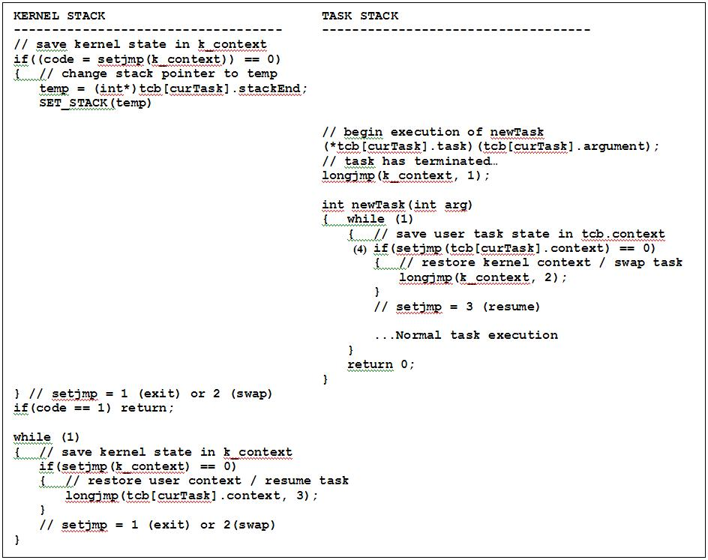
Multi-tasking in C
setjmp/longjmp

Slide 8
Step 2: Schedule w/Ready Queue
Project 2 Assignment
•••
Priority/TID
Priority/TID
Priority/TID
Priority/TID
# of entries
Create a ready priority queue
PQueue rq; // ready queue
rq = (int*)malloc(MAX_TASKS * sizeof(int));
rq[0] = 0; // init ready queue
Add new task to ready queue in createTask
enQ(rq, tid, tcb[tid].priority);
Change scheduler() to deQueue and then enQueue next task
if ((nextTask = deQ(rq, -1)) >= 0)
{
enQ(rq, nextTask);
}
rq[5]
rq[4] | 10 / 3
rq[3] | 5 / 2
rq[2] | 5 / 0
rq[1] | 2 / 1
rq[0] | 4

Slide 9
2-State Scheduler
P2 - Tasking
createTask()
dispatch()
killTask()
Ready
Queue
New
Running
Exit
swapTask()
nextTask = enQueue(rq, deQueue(rq, -1));

Slide 10
Chapter 5 Learning Objectives
Discuss basic concepts related to concurrency, such as race conditions, OS concerns, and mutual exclusion requirements.
Understand hardware approaches to supporting mutual exclusion.
Define and explain semaphores.
Define and explain monitors.
Explain
Producer/Consumer
Bounded buffer
Readers/writers problem
Classical synchronization problems

Slide 11
Review…
Mutual Exclusion
The OS must keep track of active processes.
The OS must allocate and deallocate resources.
Processor time
Memory
Files
I/O devices
The OS must protect the data and physical resources.
The results of a process must be independent of the speed of execution relative to the speed of other concurrent processes.
Notes:
11

Slide 12
Resource Allocation
Mutual Exclusion
Mutual Exclusion
Critical resource – a single nonsharable resource.
Critical section – portion of the program that accesses a critical resource.
Deadlock
Each process owns a resource that the other is waiting for.
Two processes are waiting for communication from the other.
Starvation
A process is denied access to a resource, even though there is no deadlock situation.
Notes:
12

Slide 13
Semaphores
Semaphores
SEM_SIGNAL
Producer
SEM_WAIT
Consumer
SEM_TRYLOCK
Conditional consumer
Semaphores used for:
Synchronization
Resource
Mutual Exclusion
Notes:
13

Slide 14
Consider…
Semaphores
P0:
wait(S);
wait(Q);
.
.
.
signal(S);
signal(Q);
P1:
wait(Q);
wait(S);
.
.
.
signal(Q);
signal(S);
Is there anything wrong here?
Notes:
14
How does deadlock occur?
P0 gets into S; interrupt; P1 gets into Q, waits on S; interrupt; P0 is waiting on Q

Slide 15
The Producer-Consumer Problem
Producer/Consumer
Producer
Consumer
repeat
…
produce an item in nextp
…
while (counter == n);
buffer[in] = nextp
in = (in + 1) mod n
counter = counter + 1
until false
repeat
…
while (counter == 0);
nextc = buffer[out]
out = (out + 1) mod n
counter = counter - 1
…
consume the item in nextc
…
until false
Is there anything wrong here?

Slide 16
Autonomy
Semaphores
Critical
Semaphore operations must be atomic
Uniprocessor
simply inhibit interrupts (normal user can’t)
Use TestAndSet to create a mutex in the calls
Multiprocessor
hardware must provide special support, or
use software solutions
semWait(Semaphore s)
{
while(TestAndSet(&lock));
s.value--;
if (s.value < 0)
{
add process to s.queue
*lock = FALSE;
block;
}
else *lock = FALSE;
}
Notes:
16

Slide 17
Semaphores
Semaphores
Binary Semaphore
2 states
0 = nothing produced, maybe tasks in queue
1 = something produced, no tasks in queue
Counting Semaphore
Resource counter
0 = nothing produced, nothing in queue
-n = nothing produced, n tasks queued
+n = n items produced, no tasks in queue

Slide 18
SEM_SIGNAL - Producer
Semaphores
void semSignalBinary(Semaphore* semaphore) // signal binary semaphore
{
semaphore->state = 1; // produce (signal) binary semaphore
if (tid = deQ(semaphore->queue) < 0) return; // dequeue blocked task (if any)
semaphore->state = 0; // consume (clear) semaphore
tcb[tid].state = S_READY; // ready task for execution
enQ(rq, tid); // move task to ready queue
return;
} // end semSignalBinary
void semSignalCounting(Semaphore* semaphore) // signal counting semaphore
{
if (++semaphore->state > 0) return; // return if nothing in queue
tid = deQ(semaphore->queue); // dequeue task
tcb[tid].state = S_READY; // ready task for execution
enQ(rq, tid); // move task to ready queue
return;
} // end semSignalCounting
Notes:
18

Slide 19
SEM_WAIT - Consumer
Semaphores
void semWaitBinary(Semaphore* semaphore) // wait binary semaphore
{
if (semaphore->state == 1) // signaled?
{
semaphore->state = 0; // y, consume semaphore
return; // return w/no block
}
// resource not available, block task
tcb[curTask].state = S_BLOCKED; // change task state to blocked
enQ(semaphore->queue, deQTask(rq, curTask)); // move from ready to blocked queue
swapTask(); // reschedule the tasks
return; // returning from blocked state
} // end semWaitBinary
Notes:
19

Slide 20
SEM_WAIT - Consumer
Semaphores
void semWaitCounting(Semaphore* semaphore) // wait counting semaphore
{
semaphore->state--; // consume
if (semaphore->state >= 0) return; // if available, return
// resource not available, block task
tcb[curTask].state = S_BLOCKED; // change task state to blocked
enQ(semaphore->queue, deQTask(rq, curTask)); // move from ready to blocked queue
swapTask(); // reschedule the tasks
return; // returning from blocked state
} // end semWaitCounting
Notes:
20

Slide 21
Step 3: 5-State Scheduling
Project 2 Assignment
Add priority queue to semaphore struct
typedef struct semaphore // semaphore
{ struct semaphore* semLink; // link to next semaphore
char* name; // semaphore name (malloc)
int state; // state (count)
int type; // type (binary/counting)
int taskNum; // tid of creator
PQueue q; // blocked queue
} Semaphore;
Malloc semaphore queue in createSemaphore
semaphore->q = (int*)malloc(MAX_TASKS * sizeof(int));
semaphore->q[0] = 0; // init queue
semWait: deQueue current task from ready queue and enQueue in semaphore queue
semSignal: deQueue task from blocked queue and enQueue in ready queue.

Slide 22
5-State Scheduler
P2 - Tasking
#define SWAP swapTask();
#define SEM_WAIT(s) semWait(s);
#define SEM_SIGNAL(s) semSignal(s);
#define SEM_TRYLOCK(s) semTryLock(s);
dispatch()
Ready
Queue
New
Running
Exit
createTask()
swapTask()
killTask()
semSignal()
semWait()
semTryLock()
Blocked
Queues

Slide 23
Task Scheduling
Scheduling
Scheduler / Dispatcher
Ready Priority Queue
Executing
SWAP
SEM_SIGNAL
Semaphore Priority Queue
SEM_WAIT
SEM_SIGNAL
SEM_WAIT
Semaphore Priority Queue
SEM_SIGNAL
Semaphore Priority Queue
SEM_WAIT
…

Slide 24
Step 4a: Counting Semaphore
Project 2 Assignment
Add counting functionality to semaphores
os345semaphores.c: semSignal, semWait, semTryLock
Replace goto temp;
Add a 10 second timer (tics10sec) counting semaphore to the polling routine (os345interrupts.c).
#include <time.h> header.
Call the C function time(time_t *timer).
semSignal the tics10sec semaphore every 10 seconds.
Create a reentrant high priority timing task that
blocks (SEM_WAIT) on the 10 second timer semaphore (tics10sec).
when activated, outputs a message with the current task number and time and then blocks again.

Slide 25
Step 4b: List Tasks
Project 2 Assignment
Modify the list tasks command to
Display all tasks in all system queues in execution/priority order
List task name, if the task is ready, paused, executing, or blocked, and the task priority.
If the task is blocked, list the reason for the block.
Use the project2 command to schedule timer tasks 1 through 9, 2 signal tasks and 2 “ImAlive” tasks.
The tics10sec task about the current time every 10 seconds in a round robin order. (Round Robin)
The “ImAlive” tasks will periodically say hello. (Blocking)
The high priority “Signal” tasks should respond immediately when semaphore signaled. (Priority)

Slide 26
Step 4c: Verification
Project 2 Assignment
Demo
# | Task Name | Priority | Time slice | Blocking Semaphore
0 | CLI w/pseudo-input interrupts | 5 | 1 | inBufferReady
1-9 | TenSeconds | 10 | 1 | tics10sec
10 | sTask1 | 20 | 1 | sTask10
11 | sTask2 | 20 | 1 | sTask11
12 | ImAlive | 1 | 1 | None
13 | ImAlive | 1 | 1 | None

Slide 27
Task Control Block (tcb)
P2 - Tasking
State = { NEW, READY, RUNNING, BLOCKED, EXIT }
Priority = { LOW, MED, HIGH, VERY_HIGH, HIGHEST }
// task control block
typedef struct // task control block
{
char* name; // task name
int (*task)(int,char**); // task address
int state; // task state (P2)
int priority; // task priority (P2)
int argc; // task argument count (P1)
char** argv; // task argument pointers (P1)
int signal; // task signals (P1)
// void (*sigContHandler)(void); // task mySIGCONT handler
void (*sigIntHandler)(void); // task mySIGINT handler
// void (*sigKillHandler)(void); // task mySIGKILL handler
// void (*sigTermHandler)(void); // task mySIGTERM handler
// void (*sigTstpHandler)(void); // task mySIGTSTP handler
TID parent; // task parent
int RPT; // task root page table (P4)
int cdir; // task directory (P6)
Semaphore *event; // blocked task semaphore (P2)
void* stack; // task stack (P1)
jmp_buf context; // task context pointer (P1)
} TCB;
Pending semaphore when blocked.

Slide 28
Bounded Buffer Solution
Bounded Buffer
Shared semaphore: empty = n, full = 0, mutex = 1;
repeat
produce an item in nextp
wait(empty);
wait(mutex);
add nextp to the buffer
signal(mutex);
signal(full);
until false
repeat
wait(full);
wait(mutex);
remove an item from buffer
place it in nextc
signal(mutex);
signal(empty);
consume the item in nextc
until false
Notes:
28

Slide 29
Shared Memory
Message Passing
Single atomic variables (semaphores, modes)
Memory mapping (data structures, messages)
Test-and-set (atomic instructions)
Fast – do not require data movement (reference)
Ported memory
Multi-processor systems
Notes:
29

Slide 30
Synchronization
Classical Synchronization Problems
Reader/Writer
Barbershop
Dining philosophers
Current System Implementations
Delta Clock

Slide 31
Readers and Writers Problem
Reader/Writer
Data object is shared (file, memory, registers)
many processes that only read data (readers)
many processes that only write data (writers)
Conditions needing to be satisfied:
many can read at the same time (patron of library)
only one writer at a time (librarian)
no one allowed to read while someone is writing
Different from producer/consumer (general case with mutual exclusion of critical section) – possible for more efficient solution if only writers write and readers read.
Solutions result in reader or writer priority

Slide 32
Readers/Writers (priority?)
Reader/Writer
Semaphore rmutex=1, wmutex = 1;
integer readcount = 0;
Only one writer at a time
while(true)
{ wait(wmutex);
<write to the data object>
signal(wmutex);
};
The first reader makes sure no one can write
while(true)
{ wait(rmutex);
readcount++;
if (readcount == 1) wait(wmutex);
signal(rmutex);
<read the data>
wait(rmutex);
readcount--;
if (readcount == 0) signal(wmutex);
signal(rmutex);
};
Readers have priority!
(subject to starvation)
Last one out allows writing again
More than one reader at a time

Slide 33
Writers/Readers (priority?)
Reader/Writer
Semaphore outerQ, rsem, rmutex, wmutex, wsem = 1;
while(true)
{ wait(outerQ);
wait(rsem);
wait(rmutex);
readcnt++
if (readcnt == 1)
wait(wsem);
signal(rmutex);
signal(rsem);
signal(outerQ);
READ
wait(rmutex);
readcnt--;
if(readcnt == 0)
signal(wsem);
signal(rmutex);
};
Additional readers queue here allowing writers to jump ahead of the readers
while(true)
{ wait(wmutex);
writecnt++;
if (writecnt == 1)
wait(rsem);
signal(wmutex);
wait(wsem);
WRITE
signal(wsem);
wait(wmutex);
writecnt--;
if (writecnt == 0)
signal(rsem);
signal(wmutex);
};
Disable writers
Wait here until all readers done
Once a writer wants to write – no new readers allowed
Last reader out allows writers
Last writer out allows readers
Notes:
Writer’s priority is much more difficult! This demonstrates a very import pattern.
rmutex – protects incrementing readcnt
rsem – stops readers when writers want to go.
outer – allows writers to jump ahead of the readers
writer doesn’t have to wait on reader’s queue – wait at most on 1 reader.
rsem limits the number of readers
What about letting 4 in? Change outer to 4
Again, semaphores must have FIFO queues!!!
A writer can jump in anytime.

Slide 34
Barbershop Problem
Barbershop
3 barbers, each with a barber chair
Haircuts vary in time
Sofa can hold 4 customers
Maximum of 20 in shop
Customers wait outside if necessary
When a chair is empty:
Customer sitting longest on sofa is served
Customer standing the longest sits down
After haircut, customer pays cashier at cash register
Algorithm has a separate cashier, but often barbers also take payment
Barber chairs
Cashier
Entrance
Standing
room area
Exit
Sofa

Slide 35
Fair Barbershop
Barbershop
procedure customer; procedure barber; procedure cashier;
var custnr: integer; var b_cust: integer begin
begin begin repeat
wait ( max_capacity ); repeat wait( payment );
/* enter_shop */ wait( cust_ready ); wait( coord );
wait( mutex1 ); wait( mutex2 ); /* accept payment */
count := count + 1; dequeue1( b_cust ); signal( coord );
custnr := count; signal( mutex2 ); signal( receipt );
signal( mutex1 ); wait( coord ); forever
wait( sofa ); /* cut hair */ end;
/* sit on sofa */ signal( coord );
wait( barber_chair ); signal( finished[b_cust] );
/* get up from sofa */ wait( leave_b_chair );
signal( sofa ); signal( barber_chair );
/* sit in barber chair */ forever
wait( mutex2 ); end;
enqueue1( custnr );
signal( cust_ready );
signal( mutex2 );
wait( finished[custnr] );
/* leave barber chair */
signal( leave_b_chair );
/* pay */
signal( payment );
wait( receipt );
/* exit shop */
signal( max_capacity );
end;
program barbershop2;
var max_capacity: semaphore (:=20);
sofa: semaphore (:=4);
barber_chair, coord: semaphore (:=3);
mutex1, mutex2: semaphore (:=1);
cust_ready, leave_b_chair, payment, receipt: semaphore (:=0)
finished: array [1..50] of semaphore (:=0);
count: integer;

Slide 36
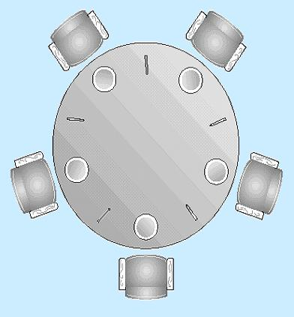
The Dining Philosophers Problem
Dining Philosophers
5 philosophers who only eat and think.
Each need to use 2 forks for eating.
There are only 5 forks.
Classical synchronization problem.
Illustrates the difficulty of allocating resources among process without deadlock and starvation.

Slide 37
Solution??
Dining Philosophers
Process Pi:
repeat
think;
wait(forks[i]);
wait(forks[(i+1)%5]);
eat;
signal(forks[(i+1)%5]);
signal(forks[i]);
forever
Each philosopher is a process.
One semaphore per fork:
forks: array[0..4] of semaphores
Initialization: forks[i].count:=1 for i:=0..4
Deadlock if each philosopher starts by picking left fork!
Notes:
Philosophers eat and think for a random amount of time.
(They are not self-aware. ha ha)
Can’t proceed if my right fork has been picked up.
Mutual exclusion
Bounded wait problem
Progress
Possible Solutions:
Only one allowed to pick up forks. If not available, put back down. (All or nothing)
2. Only allow four people to pick up – guarantees at least one to succeed.

Slide 38
Another Solution
Dining Philosophers
A solution: admit only 4 philosophers at a time that tries to eat
Then 1 philosopher can always eat when the other 3 are holding 1 fork
Introduce semaphore T that limits to 4 the number of philosophers “sitting at the table”
Initialize: T.count:=4
Process Pi:
repeat
think;
wait(T);
wait(forks[i]);
wait(forks[(i+1)%5]);
eat;
signal(forks[(i+1)%5]);
signal(forks[i]);
signal(T);
forever
Notes:
T allows only 4 people in.
Maybe not the most efficient

Slide 39
Other Solutions…
Dining Philosophers
Buy more Forks
Equivalent to increasing resources
Put fork down if 2nd fork busy
“livelock” if philosophers stay synchronized
Room Attendant
Only let 4 of the philosophers into the room at once
May have 4 philosophers in room, but only 1 can eat
Left-Handed Philosophers (asymmetric solution)
Grab forks in the other order (right fork, then left fork)
Any mix will avoid deadlock (linear ordering on forks)
A philosopher may only pick up forks in pairs.
must allocate all resources at once

Slide 40
Message Passing
Message Passing
A general method used for interprocess communication (IPC)
for processes inside the same computer
for processes in a distributed system
Another means to provide process synchronization and mutual exclusion
We have at least two primitives:
send(destination, message) or post(destination, message)
receive(source, message)
May or may not be blocking
Notes:
40

Slide 41
Synchronization
Message Passing
For the sender: it is more natural not to be blocked
can send several messages to multiple destinations
sender usually expects acknowledgment of message receipt (in case receiver fails)
PostMessage() is asynchronous – returns immediately
SendMessage() is synchronous –block until message delivered and processed
For the receiver: it is more natural to be blocked after issuing ReceiveMessage()
the receiver usually needs the info before proceeding
but could be blocked indefinitely if sender process fails before sending reply
Notes:
41

Slide 42
Addressing
Message Passing
Direct addressing:
when a specific process identifier is used for source/destination
but it might be impossible to specify the source ahead of time (ex: a print server)
Indirect addressing (more convenient):
messages are sent to a shared mailbox which consists of a queue of messages
senders place messages in the mailbox, receivers pick them up
Notes:
42

Slide 43
Mailboxes and Ports
Message Passing
A mailbox can be private
one sender/receiver pair
A mailbox can be shared among several senders and receivers
OS may then allow the use of message types (for selection)
Port: a mailbox associated with one receiver and multiple senders
used for client/server application: the receiver is the server
Notes:
43

Slide 44
Port/Mailbox Ownership
Message Passing
A port is usually owned and created by the receiving process
The port is destroyed when the receiver terminates
The OS creates a mailbox on behalf of a process (which becomes the owner)
The mailbox is destroyed at the owner’s request or when the owner terminates
Notes:
44

Slide 45
Monitor
Monitor
A software module containing:
one or more procedures
an initialization sequence
local data variables
Characteristics:
local variables accessible only by monitor’s procedures
a process enters the monitor by invoking one of its procedures
only one process can be in the monitor at any one time
Notes:
45
Need to give someone in the monitor preference to someone waiting to get into the monitor.
Check urgent queue first.
How is it implemented? Semaphores
Wrap semaphore in procedure call (wait on entry)
Signal when leaving – BUT need to look in urgent queue first, if empty, signal entry queue.
Each conditional variable is a semaphore
cwait – needs to check the urgent queue first
csignal – may have to move condition variable semaphore to urgent queue.
Good or bad?? Could be more restrictive than just using semaphores.

Slide 46
Monitor for the P/C problem
Monitor
Monitor boundedbuffer:
buffer: array[0..k-1] of items;
nextin:=0, nextout:=0, count:=0: integer;
notfull, notempty: condition;
Produce(v):
if (count = k) cwait(notfull);
buffer[nextin] := v;
nextin := nextin+1 mod k;
count++;
csignal(notempty);
Consume(v):
if (count = 0) cwait(notempty);
v := buffer[nextout];
nextout := nextout+1 mod k;
count--;
csignal(notfull);
Notes:
46

Slide 47
Conclusion
Conclusion
Semaphores are a powerful tool for enforcing mutual exclusion and to coordinate processes
But wait(S) and signal(S) are scattered among several processes.
difficult to understand their effects
Usage must be correct in all the processes
One bad (or malicious) process can fail the entire collection of processes

Slide 48
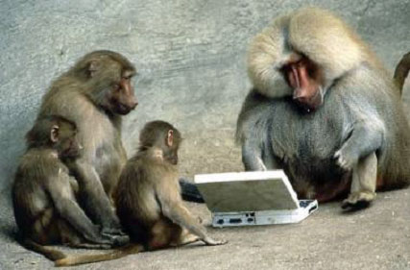
Notes:
Paul Roper
48

